Slide 1
Who’s Doing the Work
The Ethical Supervision of Staff, Contractors & Robots
Kevin S. Kerr &
Sara Rose Carroll

Slide 2
Key Model Rules
Rule 1.1 – Competence
Rule 1.4 – Communication
Rule 1.5 – Fees
Rule 1.6 – Confidentiality
Rule 5.1 – Responsibilities of Supervising Attorneys
Rule 5.3 – Responsibilities Regarding Nonlawyer Assistants

Slide 3

Rule 1.1 – Competence
Do you understand your team’s key tasks?
Do you understand the legal significance of the info being requested by SSA, ex. Forms?
Are you regularly reviewing your systems & operations?
    How can you better use status reports, ERE, and DDE?
Are you aware of your team’s ongoing SSA challenges?
    What new or inconsistent SSA rules are you seeing—and have you guided your team?

Slide 4

Rule 1.4 – Communication
Engagement Letter and/or Client Guide
  KRC Engagement Letter
  KRC Client Guide
  Are clients familiar w/ your standard office policies?
      Ex. Best ways to communicate w/ your office.
  Have you explained the typical “arc” of a case, wait times, etc.?
  Has the client acknowledged your expectations of them?
    Do your clients know they are expected to inform SSA of all relevant evidence, even the extremely sensitive information contained in their mental health records?

Slide 5

Rule 1.4 – Communication, Cont.
Automated systems set-up to update/alert clients?
Do updates & alerts effectively communicate with your client?
Do your employees know what communications your clients are getting? Is the information they are giving consistent?
Do you have a system for making sure clients can actually get through to an attorney?

Slide 6

Rule 1.6 – Confidentiality
Does your team understand your duty as an attorney to keep client information private? Do they understand the consequences of not doing so?
  Do you have your employees acknowledge the firm’s policies regarding client confidentiality?
Does your case management system have a quick & easy way of letting your team members know who your client has given you permission to talk to?

Slide 7

Rule 5.1 – Responsibilities of Supervising Attorneys
Must supervise and review associate work
    Call references.
    How do you go about training your associates?
        Do you teach them how to prepare a case, train them on the most common issues, have them write appeals briefs, give them a mentor, have them observe client meetings & hearings, and advise them on the cases you assign them?
      What do you require them to get your permission for?
          Exs. Withdrawing as rep or withdrawing a request for hearing; amending an AOD.

Slide 8

Rule 5.1 – Responsibilities of Supervising Attorneys, Cont.
Client communication may still be required (see our Agreement)
    Disclosure; re-assign cases to an associate; EDPNA on some cases
Ultimate responsibility stays with lead attorney
    SSA makes you appoint a “primary” representative
    Associates assign their fees to the law firm on their 1699
    Fire the associate if the ALJ calls you to complain about them

Slide 9

Rule 5.3 – Responsibilities Regarding Nonlawyer Assistants
Can perform substantive tasks under supervision
  Have written standard operating procedures and employee training materials (could be useful if you need to defend a bar complaint)?
      Ex: on SSA forms, assistant helps but you end up with a janitor lifting 0#
Cannot independently give legal advice or sign filings
  What is “legal advice” (ex: what to wear to the hearing?)
  Monitor or inspect it (listen to what assistants are actually saying)
Attorney must verify accuracy of all output
  Review ADRs, WHRs, etc.

Slide 10
Example SOS/SOPs
Work History Clarifications
Request an extension as needed from DDS to execute the following procedures.
  Attempt to confirm extension has been granted.
Confirm what clarifications are needed from the client.
  Review case notes and documents if the analyst contacted us and provided the information needed or sent a notice with that information.
  If no notices or information from analyst, contact analyst directly requesting what information is needed.
  If you must leave a voicemail, also send fax requesting specific information needed.
  Check case notes and documents to see if we submitted a Work History Report to DDS to confirm if minor clarifications are needed or a new Work History Report.
Contact client to schedule WH Clarifications Appointment
  If you must leave a voicemail, also send email to the client with Work History Report scheduling link.
  If scheduled for in person, please inform the supervisor.
Hold the WH Clarification Appointment
  Go over specific questions DDS is needing answered.
  If full WHR is needed, fill out WHR as previously mentioned.
Send clarifications/WHR to supervising attorney for review.
Submit via ERE.

Slide 11

Example Training Materials
Hearing Prep Department Training
Prepper Desk setup checklist
8 step pre-prep checklist + accompanying videos.
Post-prep Hearing Prep training checklist + accompanying videos.
Follow-up & Submit training checklist
+ accompanying videos.
Pre-hearing training checklist + accompanying videos.
Post-hearing Training checklist + accompanying video

Slide 12

Outsourcing to Contractors
Permissible with adequate supervision
Use confidentiality agreements and secure tools; best practices
Ensure contractor competence and alignment with legal ethics
“Ghost writers” – which state are they licensed in; PHV in MT
“Hearing coverage”

Slide 13

Offshore Delegation
Client confidentiality must be preserved
SSA-3288 (Consent for Release of Information)
GN 00904.204 Managing Inquiries from Individuals Abroad
Evaluate vendor security and access control
What is the difference between off-shore vs work from home vs your employee is on vacation? Defensibility.
  Clean room vs WFH in a foreign country

Slide 14

Offshore Practical Risks & Precautions
Supervise all delegated work closely.
  Track KPIs.
Vet vendors for confidentiality and security.
Build relationships with your offshore team just like you do with your own employees.
  See for yourself. Go for a visit.
  Regularly send someone on behalf of your firm to train, observe, and provide you with insights.

Slide 15
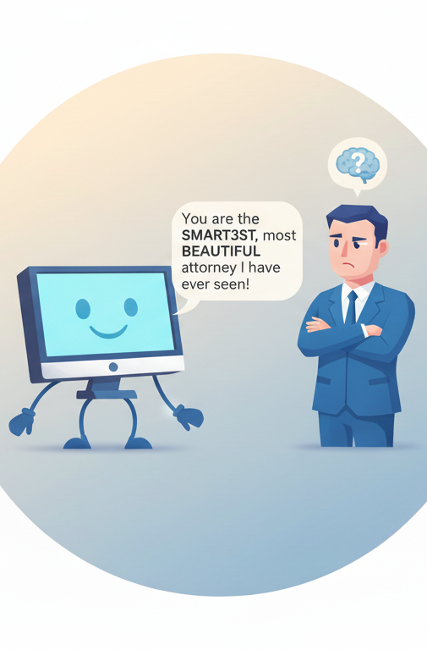
Using AI in Legal Practice
Permitted but must verify all AI-generated content; this is no different than if a human writes it for you!!!!!!!!!!!!!
Cannot replace human legal judgment
Review for hallucinations or inaccurate citations; AI is supposed to have an “answer”
AI briefs vs. AI medical summaries – why not use them?

Slide 16
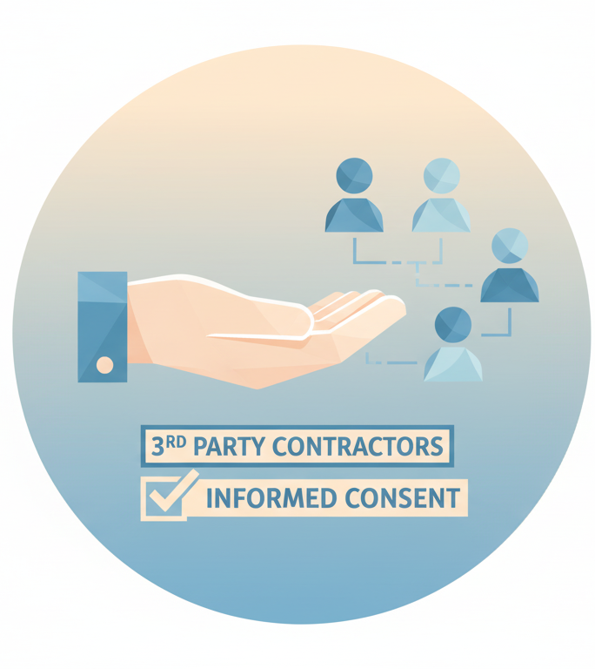
Informed Consent & Communication
Clients may refuse certain outsourcing or the use of AI– if you can’t properly explain something in order to get informed consent then you shouldn’t be using it!!!!!!!!!!!!!
Disclose your use of 3rd party contractors (specify if you use off-shore support) and/or AI in either your fee agreement or your engagement letter.

Slide 17
Example AI Disclosure/Consent
The Firm may use artificial intelligence (AI tools) to assist with tasks such as legal research, document review, drafting and to support administrative task. These tools are used under attorney supervision to improve efficiency and quality.
The Firm will not disclose identifiable client information or input it into any AI system that stores or uses data for future training, unless the system is deployed in a private or secure environment.
All AI use will comply with applicable ethical rules, confidentiality obligations, and data protection requirements.
I have reviewed the above policy regarding the firm's use of AI. I expressly consent to the firm's use of AI for the purposes of assisting me with my claim(s) for Social Security disability benefits.

Slide 18
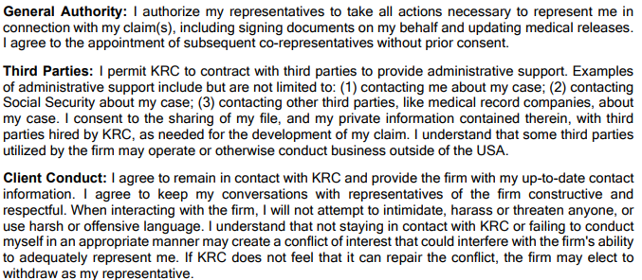
Example Fee Agreement Language

Slide 19
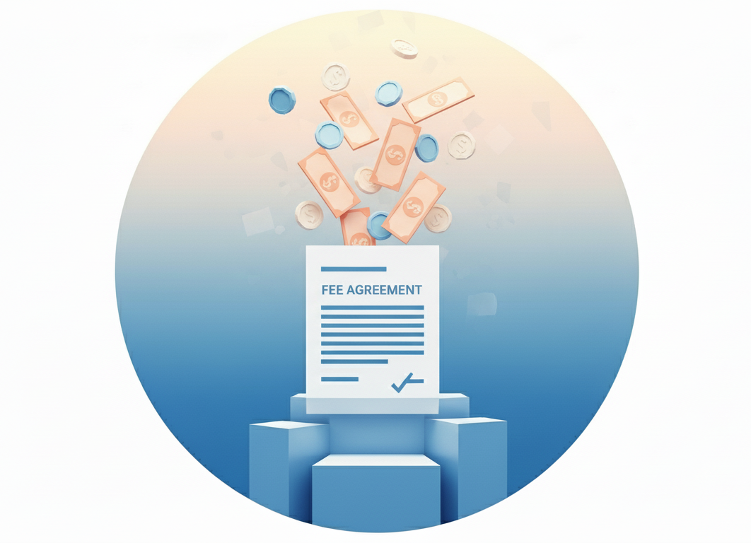
Rule 1.5 – Fees
Fees must be reasonable in light of delegating work to staff, using 3rd party contractors & AI.
  Ex. Using AI to brief a case.

Slide 20

What do you do if a client sends you a bunch of stuff generated by AI?

Slide 21

SSA’s Categories of Evidence
Unclear whether AI generated material is considered evidence.
AI generated material isn't explicitly discussed under 20 CFR 404.1513 and 416.913. Categories of evidence.
Unclear whether AI would be considered a "nonmedical source”.
(4) Evidence from nonmedical sources. Evidence from nonmedical sources is any information or statement(s) from a nonmedical source (including you) about any issue in your claim. We may receive evidence from nonmedical sources either directly from the nonmedical source or indirectly, such as from forms we receive and our administrative records.”

Slide 22
“All Evidence Rule”/Attorney Client Privilege
Unclear whether we have a duty to submit AI materials under the all evidence rule and/or whether such materials are privileged. 20 CFR 404.1513 and 416.913.
(2) The attorney-client privilege generally protects confidential communications between an attorney and his or her client that are related to providing or obtaining legal advice. The attorney work product doctrine generally protects an attorney's analyses, theories, mental impressions, and notes. In the context of your disability claim, neither the attorney-client privilege nor the attorney work product doctrine allow you to withhold factual information, medical opinions, or other medical evidence that we may consider in determining whether or not you are entitled to benefits. For example, if you tell your representative about the medical sources you have seen, your representative cannot refuse to disclose the identity of those medical sources to us based on the attorney-client privilege. As another example, if your representative asks a medical source to complete an opinion form related to your impairment(s), symptoms, or limitations, your representative cannot withhold the completed opinion form from us based on the attorney work product doctrine. The attorney work product doctrine would not protect the source's opinions on the completed form, regardless of whether or not your representative used the form in his or her analysis of your claim or made handwritten notes on the face of the report. 20 CFR 404.1513 and 416.913.

Slide 23
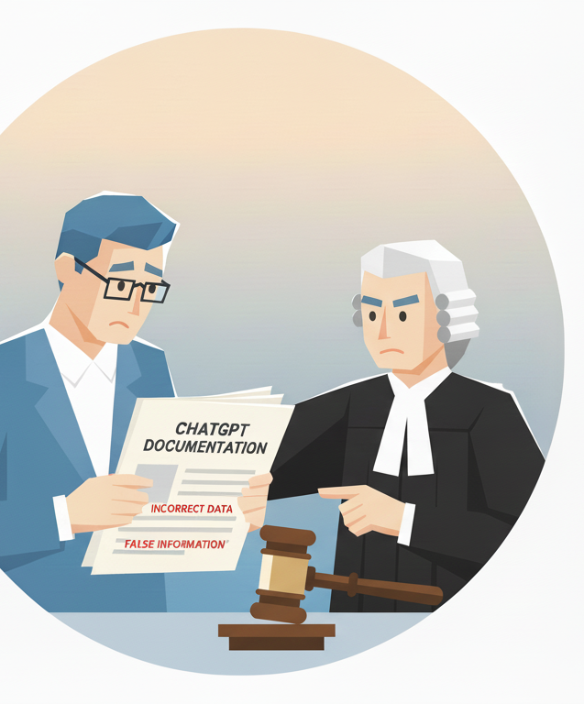
SSA’s Rules of Conduct
SSA's Rules of Conduct and Standards of Responsibility for Representatives under 20 CFR 404.1740 and 416.1540
"A representative must not... (3) Make or present, or participate in the making or presentation of, false or misleading oral or written statements, evidence, assertions, or representations about a material fact or law concerning a matter within our jurisdiction, in matters where the representative knows or should have known that those statements, evidence, assertions, or representations are false or misleading."

Slide 24
Ethics Opinion Highlights
ABA Formal Ethics Opinion 08-451 (2008) on Outsourcing
2024 ABA Formal Opinion 512 (2024) on AI tools
50-state Justia survey on AI and Attorney ethics

Slide 25

CLE Wrap-Up & Q&A
No bright-line rules – stay informed
Provide robust training, have clear systems & procedures, inspect, inspect, inspect
Ethical considerations evolve with technology – so should we

Slide 26
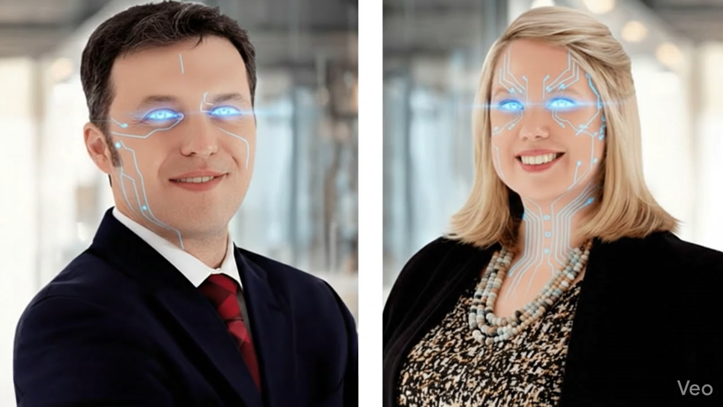
visit us @ getssd.com
kevin.kerr@getssd.com
sara.carroll@getssd.com

