Slide 1
Your Client Won: Now What?
Presented by Kevin S. Kerr &
Sara Rose Carroll

Slide 2
Overview
Don’t leave money on the table.

Slide 3
Fee Calculation: SSD/SSI
2 ways to get paid (only use one or the other) for Agency work (406(a) fee):
Fee Agreement process vs. Fee Petition process
Statutory maximum for the Fee Agreement process = 25% of “past due benefits” with a cap ($9200 for now with yearly COLA).
Definition of “past due benefits”
Fee Petition – submit your time, decision-maker decides
Amount decided by whoever found Cl. disabled (ALJ or Field Office or AC)
Court fees (406(b) fee)
25% plus agency fee (Culbertson).

Slide 4
Culbertson Fee
“[T]he 25% cap in §406(b)(1)(A) applies only to fees for court representation, and not to the aggregate fees awarded under §§406(a) and (b) . . . .” Culbertson v. Berryhill, Supreme Court 2019.
Even if SSA only withholds 25%, you are still entitled to 25% in 406(b) fees plus your agency fee (which could end up being 25% plus $9200).
Client gets $96,000 in past due benefits; file 406(b) FP for 25% or $24,000; get Fee Agreement approved for statutory maximum of $9200. If you feel bad about the fee being that high, send it back to the client; you don’t need to feel bad.
If not withheld, this is between you and your client.

Slide 5
Culbertson in Fee Agreement
What we use for the 406(a) fee and 406(b) fee:
Agency Representation: I will pay a fee of the lesser of 25% of any past-due benefits or the applicable maximum amount (set by section 42 U.S.C. § 406(a)(2)(A) of the Social Security Act).
Federal Court Representation: Federal Court attorney’s fees shall be the greater of 25% of any past-due benefits or such amounts as are awarded to my attorney by the Federal Treasury pursuant to the Equal Access to Justice Act (EAJA). I assign to my attorneys the right to receive any EAJA award directly. I authorize my attorney to endorse and deposit any checks payable to myself for EAJA fees, costs or expenses and to immediately take any amounts to which my attorney is entitled to pursuant to this agreement. Any Federal Court fee would be separate from and in addition to any fees awarded for Agency Representation, potentially resulting in up to 25% of past due benefits for Federal Court work, plus another 25% or the current maximum for agency work, as discussed above.

Slide 6
Getting Paid
Tracking
The Way We Do It
Probable Fee
SSI/SSD Set Fee
Collected Fee
Most Common Obstacles
SSA F’Ups: No NOA/No Fee Auth – Automate & Escalate Follow Up
Fee petitions – Avoid them
Fee Agreement Disapprovals – Appeal them
Fees incorrectly distributed to clients – Good Luck

Slide 7
New SSA Fee Portal
https://secure.ssa.gov/RIL/SiView.action?LVL=7&URL=/prweb/PRAuth/app/aarps/external
You need an id.me account; NOSSCR listserve has been helpful in getting people set-up.
Thanks Jennifer Cronenberg!!!!
As of writing this, the information seems minimal and not well-updated, but should be getting better (???)
You can get information about initial and reconsideration
3 categories of information
Appointments as Representative – probably also
Your “business information” (i.e. what firms they have you affiliated with)
Do they ever remove any old firms; they keep paying your old firm!
Fee Payment History – maybe?

Slide 8
Fee Petitions
If a client fired you and you would like to collect a fee you should submit a fee petition intent letter.
Determine if it should be sent to the field office or hearings office.
If there is a prior rep, or it is a USDC case, make sure you are tracking time.
The ALJ is now authorized to decide up to $15,000.

Slide 9
Fee Agreement Disapprovals
Appeal to the RCALJ
Most common issues are prior reps and “two-tiered fee agreements.”
From time-to-time ALJs will try to punish you by reducing/not approving your fee.
If there was a prior rep who did not waive fees, you will need to submit a Fee Petition.

Slide 10
Fee Waivers
Prior representatives from other firms.
Be cool. Try to engage in a little professional courtesy where it makes sense.
Multiple reps from the same firm.
Direct Payment to Entities – Form 1699
For SSI claims (what we had to do before “entities”)
Send a fee waiver so the full attorney fee can be paid to the primary rep without splitting it up between attorneys.
Add the signature for every attorney on the representation documents who isn’t the primary rep.
Ideally, you should send a fee waiver for all new SSI approvals to be proactive, but usually FOs will request them from us if they need one.

Slide 11
Fee Authorizations
Fee authorization language is needed to collect your fee, even if you have already received payment in full.
Most SSD fee auths will be found in the SSD Notice of Award letter.
Most SSI fee auths will be in a separate SSI Important Information letter.
“We have approved the fee agreement between you and your lawyer. Under the fee agreement, your lawyer can charge you no more than ($AMOUNT) their work. Your past-due benefits used to decide the amount of the fee are ($AMOUNT).”

Slide 12
PERC Meetings
The Lord Giveth…
And SSA takes away whatever they can.
Push for More Reform. Google: “Social Security Commissioner Martin O’Malley Agrees SSI Program is Outdated,” All Things Considered, NPR, June 26, 2024.
Basic PERC Qs
Have you worked at all from your protected filing date forward?
Are you currently married, or have you been married since your filing date?
Have you received SNAP benefits, TANF, or any other state assistance?
Do you own more than 1 vehicle?
Do you have a bank account that has exceeded $400 at any time?
Do you have stocks / bonds / early retirement / a life insurance policy / a 401k / an inheritance?
Do you have any burial plots in your name / any land / multiple properties?
Do you have anything of value that you can sell for a large amount of money?
Have you received any cash / gifts / loans from friends or family of a substantial amount?
Do you pay rent?

Slide 13
Notice of Disapproved Claims
These will pretty much always be for SSI claims and are typically due to the client missing the PERC appointment, not turning in PERC proof, or being over-resourced.
You should definitely appeal a NODC for clients who miss their PERC.
If additional proof is need for a PERC, contact the field office first to figure out what information is needed.
If the client is over-resourced go over the NODC with them to determine if that information is correct. If it’s not correct, appeal and try to provide proof.

Slide 14
In-kind Support & Maintenance (ISM) Appeals
For SSI claims only. These appeals are for the reductions that clients get due to income, assets, nonpayment of rent, etc.
Go through the SSI Notice and see what kind of reductions the client is getting and for what months.
Call the client and go through the reductions with them. Ask if they are correct.
If the client says something is incorrect, ask them if they will be able to provide the relevant proof.

Slide 15
SSI Non-Pursue
If the SSD benefits start earlier than and are higher than the SSI benefit max, it generally is not beneficial for the client to pursue both. The client HAS to pursue SSI benefits only if they have received general assistance from the state that they have an obligation to repay, or if they have medical expenses that they want Medicaid to reimburse.

Slide 16
Auxiliary (Aux) Benefits
Clients who have children and are receiving SSD benefits may be able to get extra monthly payments for those children. SSA refers to them as the client’s auxiliary. The auxiliary information is usually found in the SSD NOA.
Let the client know that they may be eligible to receive extra benefits for their children. All they need to do is call their local SSA Field Office (provide that phone number to them) and tell the client to tell SSA that they want to file an application for aux benefits. Let the client know that they have 6 months from the date of their SSD NOA to file for aux benefits.
If you have not hit the maximum attorney fee yet, you can also collect extra attorney fees on the aux as long as that is in your fee agreement with the client.

Slide 17
SSI & Requirement to Apply for Other Benefits
SSA will issue a Notice of Disapproved Claim for SSI if there are other government benefits that Cl. could apply for.
SSI is a program of last resort.
This include WC or VA benefits.
If you apply for SSI you will have to apply for SSR or widow/widower benefits if you are above the applicable age.

Slide 18
Continuing Disability Reviews
Check out the end of the decision. The judge may recommend a continuing disability review. SSA may do one regardless.
Usually, they are just going to be for younger individuals.
They often times do them for people who have mental health impairments.
SSA says the frequency of the review depends on the nature and severity of the client’s medical condition.
It’s really important to encourage clients to continue with treatment and let them know that these reviews may happen.
Clients may appeal these decisions.

Slide 19
Representative Payees
The ALJs usually make recommendations in their decision about Rep Payees.
If the client does not want a representative payee, tell them to call their local Field Office and ask for a “capability review” with them
If the client thinks having a rep payee is a good idea, tell them to have the information of their rep payee ready and call SSA to provide that information
If the client speaks with SSA and they still determine that a rep payee is needed, the client needs to provide the information of someone they trust.
If the client does not have anyone able to do this, there are organizations that provide rep payee services. SSA may be able to assist with finding an organizational payee as well.

Slide 20
Workers’ Compensation Offset
Workers’ Compensation Screening Information:
Date of Injury (DOI)
Time loss
Settlement (If yes, how much and when?)
Claim #
Insurer
State filed

Slide 21
Workers’ Compensation Offset, cont.
Workers’ Compensation Screening Information:
Date of Injury (DOI)
Timeloss
Settlement (If yes, how much and when?)
Claim #
Insurer
State filed
Attorney
Claim Status (open or closed)
Documents Needed
Claims Disposition Agreement (CDA)
Disputed Claims Settlement (DCS)
Notice of Closure (NOC)
Timeloss Ledger
Ledger of payments received for paid time for work d/t work-related injury or illness

Slide 22
Workers’ Compensation Offset, cont.
80% Average Current Earnings (ACE)
Find year of highest pay, if within 5 years of allowed onset date, use that year’s gross earnings (x)
If no obvious year of highest pay within 5 years of allowed onset date, get average of five consecutive years of highest earnings, use that for gross annual earnings (x)
Math: x÷12=y → y×.8=z → z=80% ACE

Slide 23
Workers’ Compensation Offset, cont.
Pro-Rating Settlements (OR only, Hodge V Shalala, if not already pro-rated in settlement docs)
Find out full retirement age of CL
Find out how many months between date settlement awarded and date CL attains full retirement age
Divide gross settlement by number of months; that amount is the pro-rated payment
Math: settlement÷months=x →if x+PIA is less than 80% ACE, no WC offset; if x+PIA is greater than 80% ACE, WC offset will apply
Pro-Rating Settlements not in OR
Paid out at rate that timeloss was paid until settlement paid out, even if settlement paid in a lump sum (unless otherwise noted in settlement docs)
Ex: Gross settlement $12,000.00 paid in lump sum; timeloss prior to settlement was being paid at $2,500.00/month. 12,000÷2,500+=4.8 →Thus, pro-rating is that settlement paid out at $2,500/month for 4.8 months
Math: same as above, so if monthly payment+PIA is less than 80% ACE, then no WC offset; if monthly payment+PIA is greated than 80% ACE, then WC offset will apply
In example above, say CLs PIA is $1,500 and 80% ACE is $3,500; 2500+1500=4,000, greater than 80% ACE of 3,500, so offset would apply for the 4.8 pro-rated months, then offset would end

Slide 24
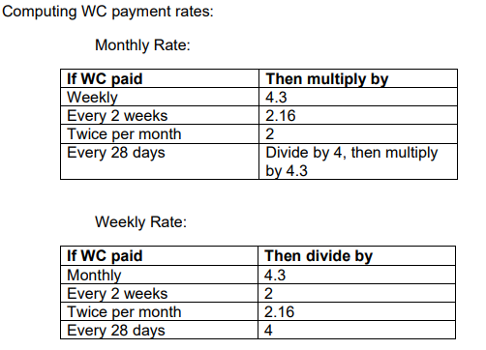
Workers’ Compensation Offset, cont.

Slide 25
Long Term Disability (LTD)
Be specific with the client re: your scope of representation. Tell them to consult an LTD attorney re: any questions they have about how their SSD case may impact their LTD benefits.
Make sure the client understands that winning their SSD case may result in $0 extra money for them.
They should consult their contract with their LTD insurer.
They may be required under their contract to pursue SSD benefits. For how long (how many appeals)? Most contracts we have seen are pretty unclear. They should clarify with their insurer.
Even though the their SSD back pay and ongoing benefits may not go to them, it could be to their advantage for other reasons, like Medicare.

Slide 26
Onset Date Appeals
Figure out what your argument would be for an earlier onset date.
Figure out why DDS gave the EOD they did. Usually, it’s the date of a CE or X number of days before a CE, when a client met a listing, or when the client changes age categories.
Examples of good facts to support an onset date appeal
Client’s last SGA job definitely ended due to their conditions, and you have good documentation of that.
There was a major event that put the client off work prior to the EOD.
DDS was being very technical focusing on when the listing was met, but it was ridiculous to think that person wouldn’t have missed 2+ days of work up until that point.
Ex. EOD based on vision listing, but had intense pain due to eye pressure for years prior to that.
Evaluate the risk.
You should explain the risk to the client before you do the appeal. However, the risk can’t really fully be evaluated until a hearing date is scheduled. Then you can consider:
How disabled are they now?
Who is the judge?

Slide 27
Appealing Partially Favorable Decisions
You should have a standardized review process for reviewing ALJ Partially Favorable Decisions.
Always explain a client’s appeal rights to them, especially if they will be giving up the SSD component.
Like onset date appeals, there is risk involved that you should explain to your client.
AC Exceptions – Not our jam. However, there are other reputable NOSSCR members who disagree.

Slide 28
Closed Periods
Don’t do a lot of these? I guess you and your client don’t like $.
JUDGES LOVE TO PAY CLOSED PERIOD CASES.
Clients can always reapply.
Cool things happen like disability freezes that can help adjust expired DLIs and help if they need to reapply.
Chase those unicorn cases: closed period + ongoing benefits.
Your client essentially gets 2 free months of benes past the end date of the closed period.
Ex. PFD-4/20/21 (SSI) 5/19/21 (SSD), AOD-9/1/19, DLI-12/25, PF closed period 3/21/21-4/16/23, SSD benefits from 9/21, 22m thru 6/23; SSI 5/21-9/21

Slide 29
Don’t quit after an ALJ Win
Benefits beyond SSA; you can help your client a lot more than just getting them a $900 PIA.
Some examples of other ways we help:
VA benefits
Student loan forgiveness – went from medium to easy to now what?
Medicare – don’t get your client with massive health problems a $900 PIA and then get them kicked off state Medicaid and have worse insurance.

Slide 30
Screening for VA/TDIU
VA clients
If 70%-90% and not working (or working below the poverty level) the client could be eligible for Individual Unemployability (TDIU).
TDIU pays at the 100% rate.
In many cases, if your client is approved for SSD then they will get approved for TDIU.
Submit ALJ decision to VA along with a VA Form 21-8940.
Likely VA should have already considered your client for TDIU and an appeal may be filed for an earlier effective date.

Slide 31
Student Loan Forgiveness
Total and Permanent Disability (TPD) Student Loan Discharge
They probably can just do this on their own. Put up info on your website.
If client is a veteran with a service-connected disability, receiving Social Security Disability Insurance (SSDI) with a 5 to 7-year review cycle, or their treating medical provider states they have a disability that has lasted or will last for 60 months, they may be able to get your student loans discharged.
Who knows what will happen politically.

Slide 32
Medicare: Effective Date
After a disability finding the client will be automatically enrolled in Medicare
Medicare comes in different parts.
A is for hospital
B is for other doctor’s visits
C is for Medicare Advantage plans that combines A, B and sometimes D
D is for prescription medications
Client will only be automatically enrolled in Parts A and by SSA*
After 24 months from the SSD effective date = entitlement to Medicare
If retro finding, then Part A is 24 months, Part B comes with NOA
Example: NOD FF is 10/1/24 and finds client disabled on 1/1/22. SSD effective date is 6/22 (after the 5 month wait). Medicare eligibility will start 6/1/24 (24 months after SSD effective date). Part A would be effective 6/1/24. Part B would be effective with the NOA (likely 10/1/24).
If you are aging into Medicare at age 65, you are not automatically enrolled.
You only have a 7-month window to enroll around your 65th birthday
You have to actively sign up

Slide 33
Medicare: Effective Date
If the NOA is within 3 months of the Medicare Part B finding, SSA will enroll them starting at that point.
Same example: NOD FF is 10/1/24 and finds client disabled on 1/1/22. SSD effective date is 6/22 (after the 5 month wait). Medicare eligibility will start 6/1/24 (24 months after SSD effective date). Part A would be effective 6/1/24. Part B would be effective with the NOA (likely 10/1/24). But what if they set the Part B date for 6/1/24 too???
The client didn’t use that and still need to pay for it??
Tell your client to appeal. They might be able to get that money back.

Slide 34
Medicare: Premiums
Medicare costs money.
Part A = no cost for most people who have at least 40 quarters of Medicare-covered earnings. You already paid for it with your taxes. If you didn’t, then it’s up to $505.
*Part B = $174.70 in 2024.
Part C = $0-$200, average is about $18.50
*Part D = $0-$200, average is about $55
*May be higher depending on income or penalties, may be paid for by state benefits
*May be higher due to penalties, may be paid for by state benefits

Slide 35
Medicare: Penalties
The feds want you in Medicare!!! If you don’t sign up when you should have, you will be penalized. Avoid late enrollment penalties!!!!
A = 10% of monthly premium for 2 years – it’s free! So always sign up when you about to be 65. No reason not to have the extra coverage.
B = 10% every year you didn't sign up
D = 1% each month you didn't sign up
Penalties are waived if you have credible other coverage like private or group health insurance through an employer. VA coverage is credible for Part D but not Part B.
Remember that SSA only automatically enrolls you in Part A and B, so you need to tell your clients about this penalty for Part D.

Slide 36
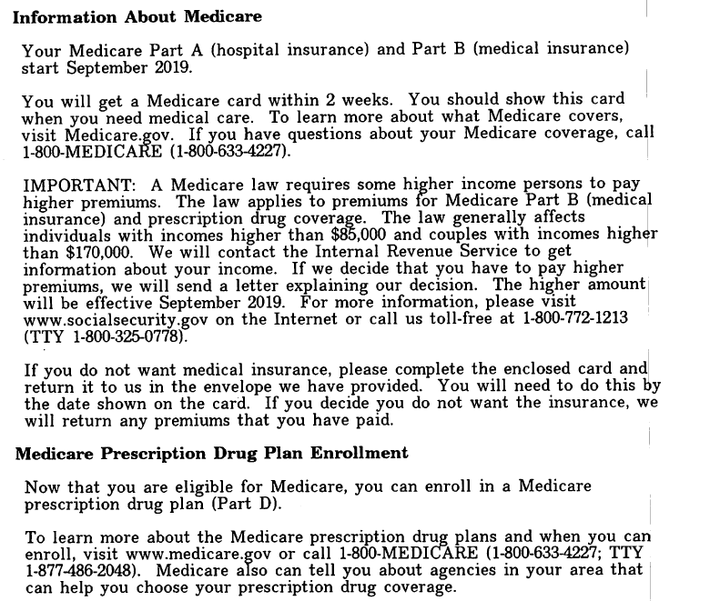
Medicare: Penalties
§ 404.1740. Rules of conduct and standards of responsibility for representatives.
“A representative must know …”
Don’t worry if you forget. It’s in the NOA.

Slide 37
Medicare: D plans
Medicare Part D covers prescription medications
Remember a client isn’t automatically enrolled in this.
UNLESS they are low income and already enrolled in their state’s health insurance.
Extra Help is a program by Medicare to reduce the copays and premiums on these plans.
In order to utilize the Extra Help Program, the person needs to be enrolled in a D plan. Your client might get a random prescription drug card in the mail after their Medicare card. That’s this.

Slide 38
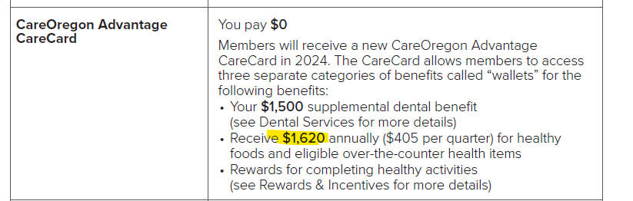
Medicare: C plans
Medicare Part C plans combine Parts A and B and sometimes D. They give extra benefits.
What’s an extra benefit? Medicare doesn’t cover vision, hearing, dental acupuncture. Most C plans come with that. They also give perks like a gym membership or OTC/flex dollars to use on OTC products, worldwide ER coverage.
There are tons of plans that have no additional premium, so the client is essentially getting a free pair of glasses, a free gym membership, free preventative dental for no more cost.

Slide 39
Medicare: C plans
Who would be right for a C plan?
A client who has Medicaid coverage to cover cost sharing
A client who doesn’t have Medicaid coverage to cover cost sharing but is OK with some copays.
$0 PCP visits, $20 specialty visit, $250-$500 copay for a surgery in an Ambulatory Surgery Center, $20-$150 for an MRI, $400-$700 for a two-day ER stay
Maximum Out of Pocket costs under these plans range from $3K - $8,850
A client whose doctors are already in the plan’s network. If you are going there anyway??
Who would be wrong for a C plan?
A client who has other credible coverage through a spouse’s employer.
A client who doesn’t have Medicaid coverage AND would be expected to meet the Maximum Out of Pocket charges every year.
A client who needs the flexibility to go to doctors in different networks or in different states
What about Veterans?
A client with VA coverage might get a C plan with a Part B kickback. Or they might get a normal plan to allow them other options to see outside providers.
A client with Tricare for Life who is required to enroll in Medicare has no cost share already so they might get a C plan with a Part B kickback.

Slide 40
Medicare: Other options
If a C plan isn’t the right fit, there are other options.
Original Medicare (A+B) and a stand-alone D plan.
You won’t have dental, vision or hearing coverage but some carriers offer these policies individually.
You will be able to see any doctor who takes Medicare (which is like 90% of providers)
Medicare Supplement or Medigap policy
This will cover a lot of Medicare copays and coinsurances
You still need a D plan
These plans cost a lot more money than a no premium C plan

Slide 41
Medicare: What you need to know
Refer them to an agent.
Agents are required to do a “Medicare Needs Assessment” to determine the best option for the client.
What an agent will need to know:
List of providers to tell if they are in network
Preferred hospital of choice
List of medications to determine if they are on the plan’s formulary and what the client’s cost sharing will be for those medications
How the client prefers to fill their medications. Will they enroll in mail in?
If the client needs to have vision, hearing or dental services and the extent of the coverage needed
Whether the client might have any chronic conditions like heart disease or diabetes or whether they might qualify for the Extra Help program or have dual benefits with Medicaid
Projected services needed for the next year or so – do you know they will have two more MRIs and a knee surgery? Then they better be OK with those copays for that.

Slide 42
Medicare: What do the client’s care about
Costs! They want to make sure that their health insurance costs aren’t going to change or that they understand what those costs will be over time.
Benefits! Clients want a free pair of glasses. Or a gym membership. Or $405 a quarter in money to pay for utilities and food and OTC items.
Networks! Clients want to be able to see who they want to see.

Slide 43
Work Incentives: SSD & SSI
Subsidies & Special Conditions
Unsuccessful Work Attempts (UWAs)
Impairment Related Work Expenses (IRWE)
Plan to Achieve Self Support (PASS)
Continued Payment under Vocational Rehabilitation or Similar Program
Expedited Reinstatement
Google “SSA Red Book” for More Info on Work Incentive Programs

Slide 44
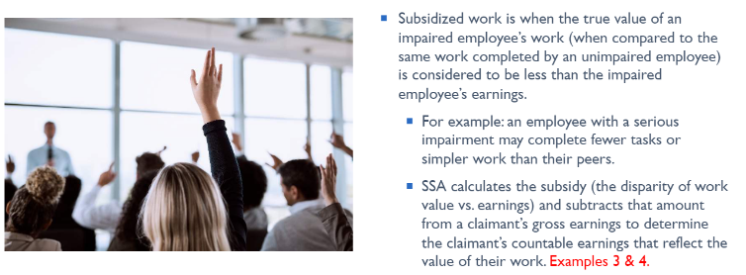
Work Incentives: Subsidized Work
Google “SSA Red Book” for More Info on Work Incentive Programs

Slide 45
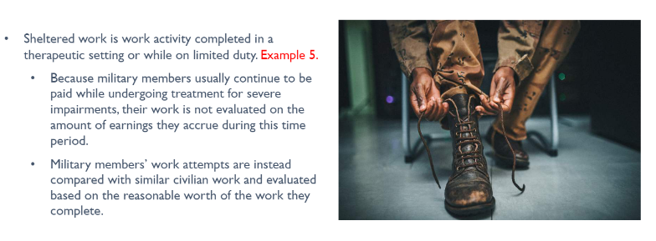
Work Incentives: Sheltered Work
Google “SSA Red Book” for More Info on Work Incentive Programs

Slide 46
Work Incentives: Unsuccessful Work Attempts
If a client is hired for a job but is unable to keep it for longer than 6 months due to their impairments, there has been an unsuccessful work attempt.
There must be at least 30 consecutive days between unsuccessful work attempts.
Google “SSA Red Book” for More Info on Work Incentive Programs

Slide 47
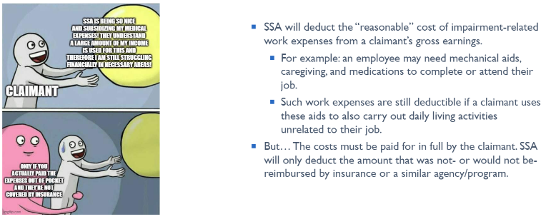
Work Incentives: Impairment Related Work Expenses (IRWEs)
Google “SSA Red Book” for More Info on Work Incentive Programs

Slide 48
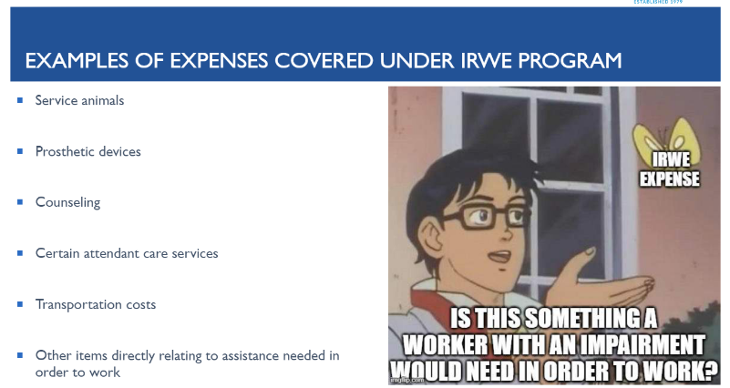
Work Incentives: IRWEs, cont.
Google “SSA Red Book” for More Info on Work Incentive Programs

Slide 49
Work Incentives: SSD Only
Trial Work Period (TWP)
Extended Period of Eligibility
Unincurred Business Expenses (Self-Employment)
Continuation of Medicare Coverage
Medicare for People with Disabilities Who Work
Google “SSA Red Book” for More Info on Work Incentive Programs

Slide 50
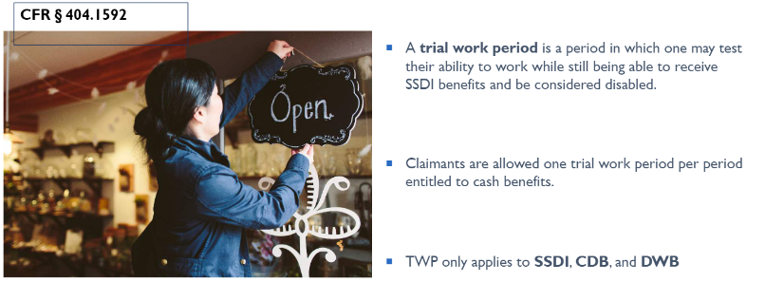
Work Incentives: TWP
Google “SSA Red Book” for More Info on Work Incentive Programs

Slide 51
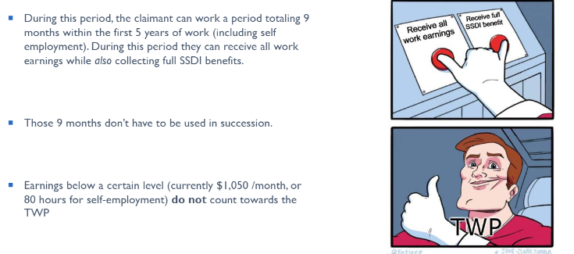
Work Incentives: TWP, cont.
Google “SSA Red Book” for More Info on Work Incentive Programs

Slide 52
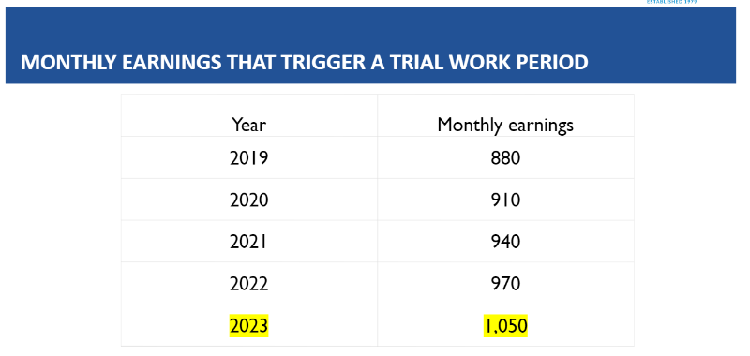
Work Incentives: TWP, cont.
Google “SSA Red Book” for More Info on Work Incentive Programs

Slide 53
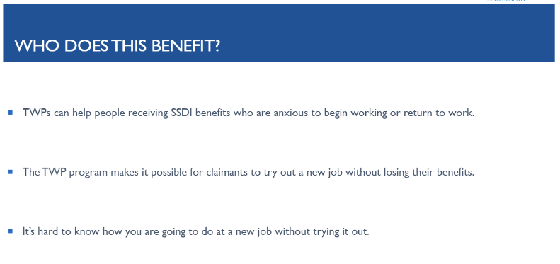
Work Incentives: TWP, cont.
Google “SSA Red Book” for More Info on Work Incentive Programs

Slide 54
Work Incentives: TWP, cont.
Google “SSA Red Book” for More Info on Work Incentive Programs

Slide 55
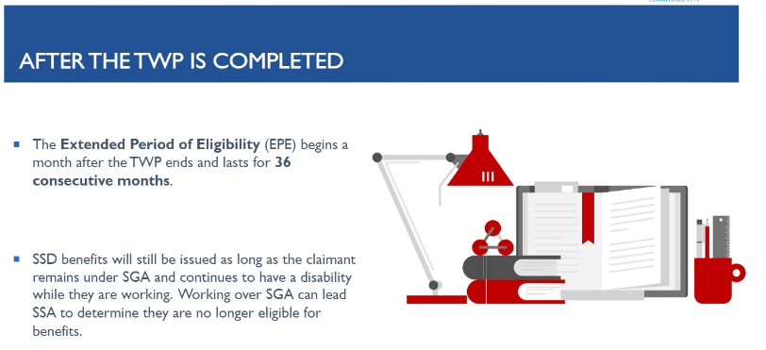
Work Incentives: Extended Period of Eligibility
Google “SSA Red Book” for More Info on Work Incentive Programs

Slide 56
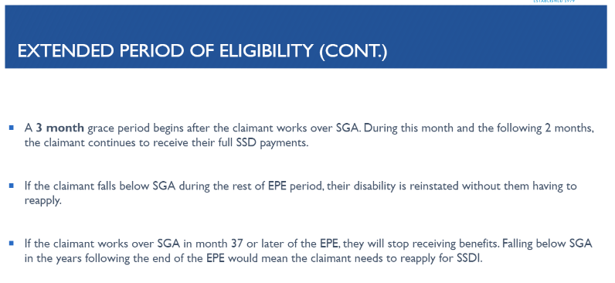
Work Incentives: Extended Period of Eligibility
Google “SSA Red Book” for More Info on Work Incentive Programs

Slide 57
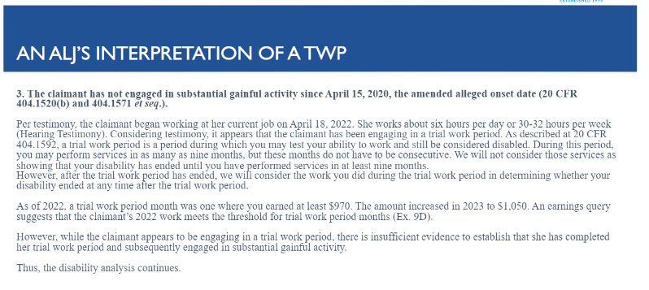
Work Incentives: Extended Period of Eligibility
Google “SSA Red Book” for More Info on Work Incentive Programs

Slide 58
Work Incentives: SSI Only
Earned Income Exclusion
Student Earned Income Exclusion
Special SSI Payments for People Who Work
Reinstating SSI Eligibility Without a New Application
Special Benefits if You are Eligible Under 1619 & Enter a Medical Facility
Medicaid While Working
Resource Exclusions
AmeriCorps
Google “SSA Red Book” for More Info on Work Incentive Programs

Slide 59



visit us @ getssd.com
kevin.kerr@getssd.com
amanda.robichaux@getssd.com
sara.carroll@getssd.com

