Slide 1
The E Section & Other Evidence
Presented by Kevin Kerr, Sara Carroll & Elmira Shokriyani

Slide 2

Overview:
Basic rules of evidence matter – Need to understand claimant’s burden & how different types of evidence are treated
“Other evidence” or “Nonmedical Evidence” can help you frame your case by:
Explaining Alleged Onset Dates
“Relating back”
Proving onset prior to the DLI
Establishing Listings
  Examples: Mental Health B & C Criteria
Tracking Symptoms, Responses to Treatment, Nonmedical Treatment & Difficulties with ADLs
Needs Assessments & Evaluations for other Programs/Services
  Examples: VA, Voc Rehab, Caregiving
Documenting Limitations in School & Work Environments
  School Records / Teacher’s Statements
  Employment Records / Employer Statements
Providing VE Rebuttal Evidence

Slide 3
Basic Rules on Evidence

Slide 4
CFRs § 404.1512 & CFR § 416.912: Responsibility for evidence.
Burden is on the client to prove they are blind or disabled.
The Agency has a duty to develop the record.
CFR § 404.1614 & CFR §:
“At our request, the State agency will obtain and furnish medical or other evidence and
provide assistance as may be necessary for us to carry out our responsibilities.”
In practice, you are probably going to have to get other/nonmedical evidence yourself.

Slide 5

CFR § 404.1513 & CFR § 416.913:
Categories of evidence.
The Categories of Evidence Are:
Objective Medical Evidence
Medical opinion
Other medical evidence
Evidence from nonmedical sources
  Defined as: “Evidence from nonmedical sources is any information or statement(s) from a nonmedical source (including you) about any issue in your claim. We may receive evidence from nonmedical sources either directly from the nonmedical source or indirectly, such as from forms we receive and our administrative records.”
Prior administrative medical findings
The categories of evidence are important because they determine how the evidence will be evaluated according to the rules pertaining to the relevant category of evidence.

Slide 6

CFR § 404.1520b & CFR § 416.920b:
How SSA Considers Evidence.
404.1520b. (a) Complete and consistent evidence
vs.
404.1520b. (b) Incomplete or inconsistent evidence
Evidence must be sufficient and consistent to be considered complete.
If it is not sufficient or consistent, and SSA cannot determine disability based on the information they have, they will attempt to resolve it.
When inconsistencies or insufficiencies can’t be resolved, SSA will make a determination or decision based on the evidence they have.

Slide 7
CFR § 404.1520b & CFR § 416.920b: How SSA Considers Evidence, Cont.
404.1520b.(c) – If evidence is considered inherently neither valuable nor persuasive, SSA will not provide any analysis about how they considered such evidence in their opinion.
Examples of evidence considered neither valuable nor persuasive:
Decisions by other governmental agencies & nongovernmental agencies
  Examples: Department of Veterans Affairs, Department of Defense, Department of Labor, Office of Personnel Management, state agencies, private insurers
  “However, we will consider all of the supporting evidence underlying the other governmental agency or nongovernmental entity's decision that we receive as evidence in your claim in accordance with § 404.1513(a)(1) through (4) [Emphasis added].”
Disability examiner findings
Statements on issues reserved to the Commissioner – i.e., statements that relate to whether an individual is disabled or blind

Slide 8

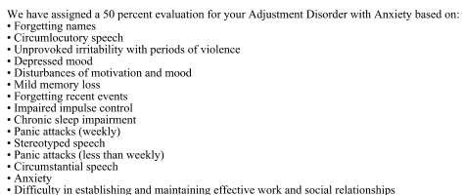
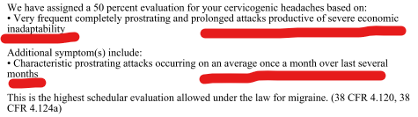
Example: VA Ratings Decision/Explanation = Supporting Underlying Evidence, That Must be Considered as Medical Evidence
1st Page Looks Like:
The Good Stuff:

Slide 9
CFR § 404.1520c & CFR § 416.920(c): No Articulation Requirement re: Nonmedical Sources for Claims Filed After March 27, 2017
  “(d) Evidence from nonmedical sources.
  We are not required to articulate how we considered evidence from nonmedical sources using the requirements in paragraphs (a)-(c) in this section.”
  Note: Nonmedical source evidence should still be considered, but decision maker is not required to articulate how they considered it.

Slide 10
Other Evidence: Establishing the AOD

Slide 11

Using Other Evidence to Determine the Onset Date
SSR 18-01p – Current Policy for Determining Onset
Primary basis: Medical evidence is the main source for determining onset.
If medical evidence is lacking: Other non-medical evidence may be considered when the claimant has a non-traumatic, exacerbating, or remitting impairment. This helps establish onset when direct medical records are incomplete.

Slide 12

Examples of Other Evidence that May be Used to Establish the Onset Date/Relate Back
Statements from the claimant or others
  Friends, Family, Caregivers, Employers
    What differences have they noticed and when did those begin?
Documentation of Specific Incidences
  Traumatic events like accidents at work
    Ex. We provided a ship log to document accident happened prior to DLI, even though client didn’t receive treatment until after the DLI.
      “ If the evidence of record supports a finding that the claimant met the statutory definition of disability on the date of the traumatic event or traumatic injury, we will use that date as the date that the claimant first met the statutory definition of disability.” (SSR 18-01p).
  Specific Incidences of Trauma
    Ex. Documentation of Revocation of Parental Rights or Police Report(s) of Domestic Violence

Slide 13
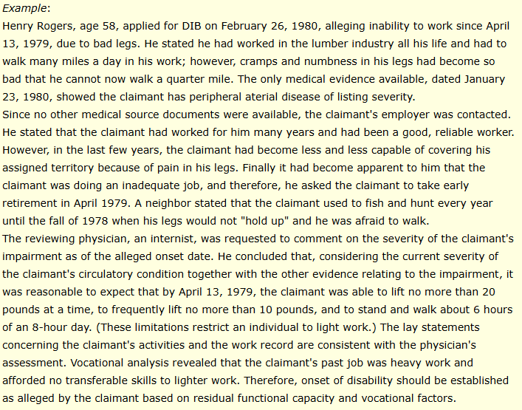
SSR 83-20 (Rescinded)

Slide 14

The Spirit of Henry Rogers Still Appears to be Alive Under 18-1p
  “The date we find that the claimant first met the statutory definition of disability may predate the claimant’s earliest recorded medical examination or the date of the claimant’s earliest medical records, but we will not consider whether the claimant first met the statutory definition of disability on a date that is beyond the period under consideration.”
  “We may consider evidence from other non-medical sources such as the claimant’s family, friends, or former employers, if we cannot obtain additional medical evidence or it does not exist (e.g., the evidence was never created or was destroyed), and we cannot reasonably infer the date that the claimant first met the statutory definition of disability based on the medical evidence in the file.”

Slide 15
Other Evidence: Establishing Listings

Slide 16

MDIs may require nonmedical evidence to establish duration & severity
Example: Migraines
SSR 19-4p – Provides guidance on:
  How SSA establishes that a person has an MDI of a primary headache disorder.
  How SSA evaluates primary headache disorders in disability claims.
How Migraines Are Evaluated Under the Listings
Epilepsy (Listing 11.02) is considered the most closely analogous impairment.
  SSA may find the migraine MDI medically equals Listing 11.02 B or D (dyscognitive seizures).
  SSA requires detailed documentation of a typical headache event, including associated phenomena, from an acceptable medical source to support the claim of equivalence.
Evidence that is (arguably) nonmedical should also be considered under 11.02 if it shows:
  Frequency of headache events.
  Adherence to prescribed treatment.
  Side effects of treatment (e.g., many medications used for treating a primary headache disorder can produce drowsiness, confusion, or inattention).
  Limitations in functioning.

Slide 17
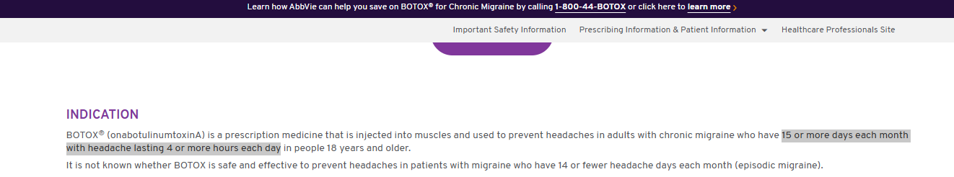
Example: Frequency of Migraines Documented by Submitting the Prescription Requirements for Botox as a Treatment for Chronic Migraines

Slide 18
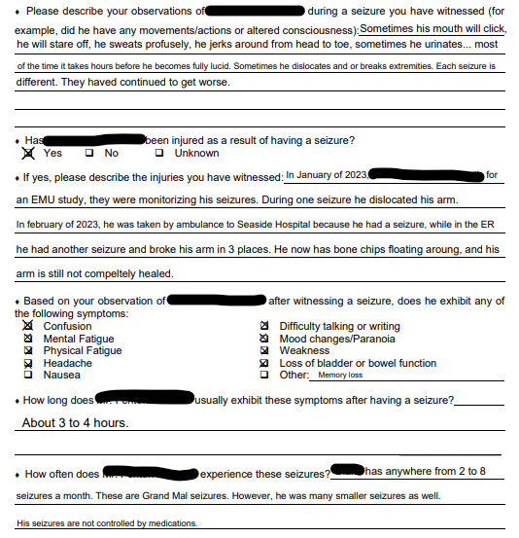
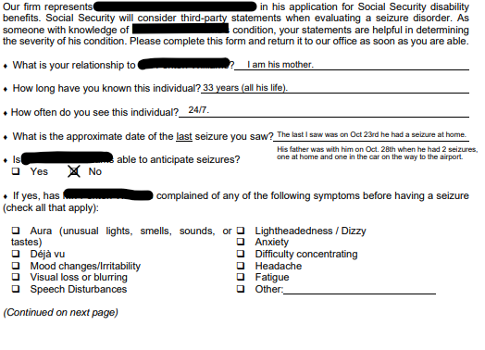
Example: 3rd Party Observation of Seizures

Slide 19

Mental Health Listings
B Criteria
  Understand, remember, or apply information
  Interact with others
  Concentrate, persist, or maintain pace
  Adapt or manage oneself
C Criteria: Mental disorder in this listing category is “serious and persistent;” that is, they have a medically documented history of the existence of the disorder over a period of at least 2 years, and there is evidence of both:
  Medical treatment, mental health therapy, psychosocial support(s), or a highly structured setting(s) that is ongoing and that diminishes the symptoms and signs of their mental disorder
  Marginal adjustment, that is, they have minimal capacity to adapt to changes in your environment or to demands that are not already part of your daily life

Slide 20
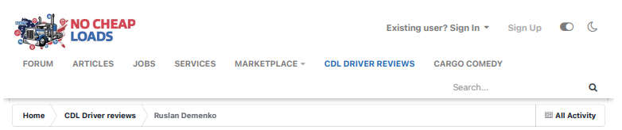
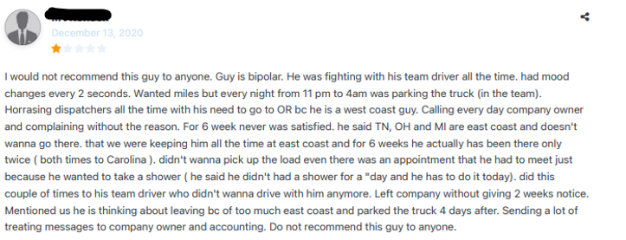
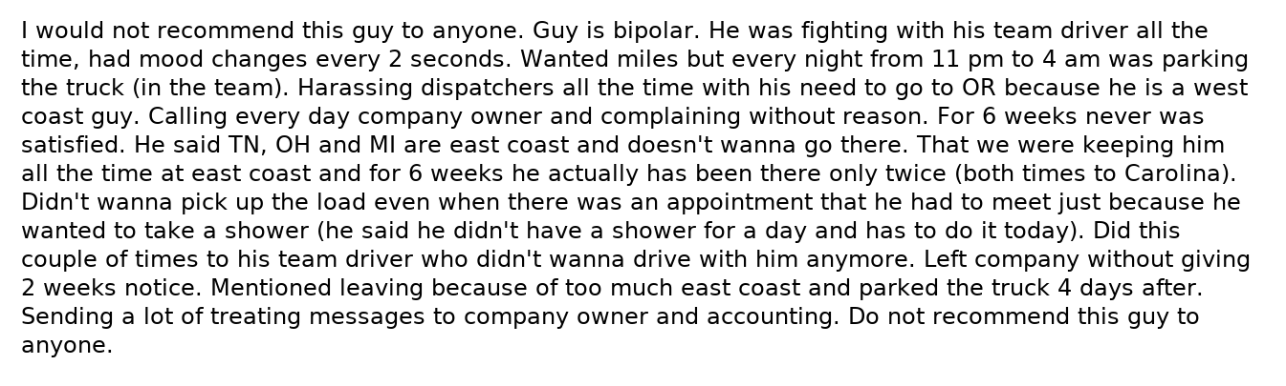
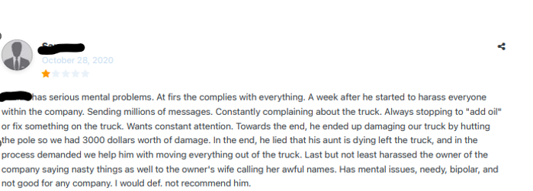
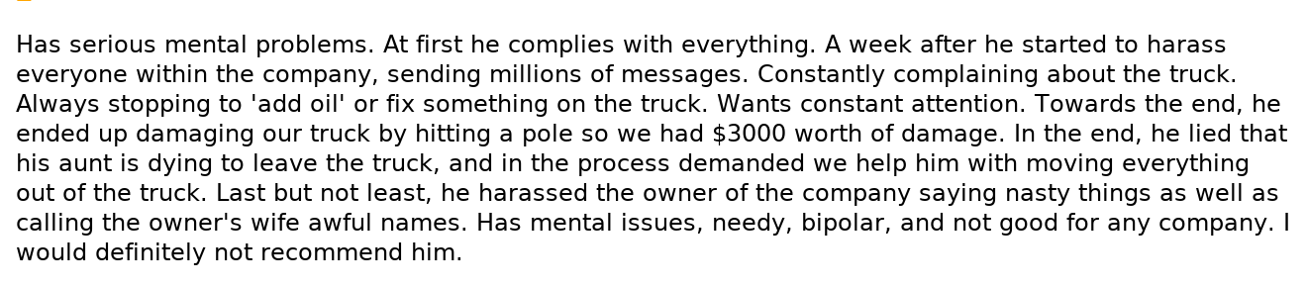
Example: Online Reviews by Employers of Client Document Mental Health Issues

Slide 21

Adaptive functioning: Intellectual Disorders (Listing 12.05)
Under either 12.05 A or B must show:
  Current Adaptive Functioning
  Manifestation prior to age 22
SSA may use school records, standardized test scores, IQ tests, special education placement, and testimony from parents, teachers, or caregivers to assess adaptive functioning.

Slide 22
Other Evidence: Symptoms, Responses to Treatment, Nonmedical Treatment & Difficulties with ADLs

Slide 23

CFR § 404.1529 & CFR § 416.929. How SSA Evaluates Symptoms, Including Pain
  “ We will consider all of your statements about your symptoms, such as pain, and any description your medical sources or nonmedical sources may provide about how the symptoms affect your activities of daily living and your ability to work.”
  “However, statements about your pain or other symptoms will not alone establish that you are disabled.”

Slide 24

CFR § 404.1529 & CFR § 416.929. How SSA Evaluates Symptoms, Including Pain, Cont.
  Will consider:
    ADLs
    Location, Duration, Frequency, & Intensity of pain or other symptoms
    Precipitating and aggravating factors
    The type, dosage, effectiveness, and side effects of any medications
    Treatment, other than medication
    Any measures used to relieve your pain or other symptoms (e.g., lying flat on your back, standing for 15 to 20 minutes every hour, sleeping on a board, etc.)
    Other factors concerning your functional limitations and restrictions due to pain or other symptoms.

Slide 25
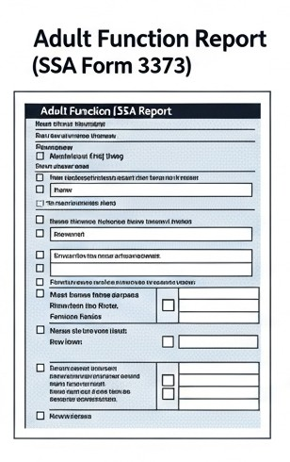
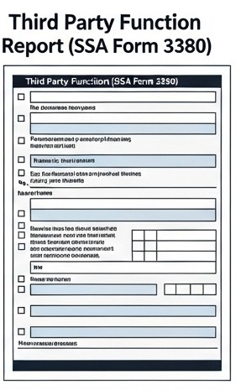
Examples of Other Evidence Documenting Symptoms, Limitations w/ ADLs, Non-Medical Treatment
  SSA Forms
    Adult Function Reports (SSA Form 3373)
    Third Party Function Reports (SSA Form 3380)
    Anybody have thoughts on commenting on forms re: how long it took to complete the form with the client, need to refocus them, etc.?
  Observation made by SSA Employees During Interviews
  Needs Assessments
    Ex. Caregiving paid for by the State
  Documentation of non-medical treatments
    Ex. Gym Attendance Log – Water Therapy
  Symptom Logs

Slide 26
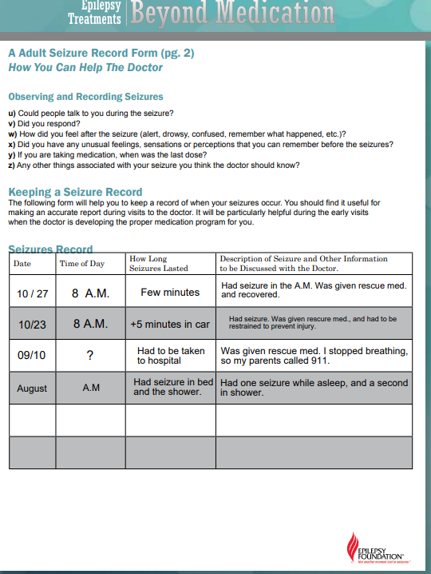
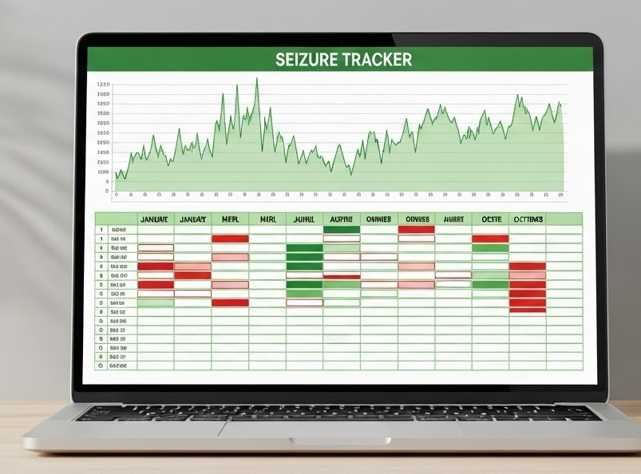
Example: Seizure Logs

Slide 27
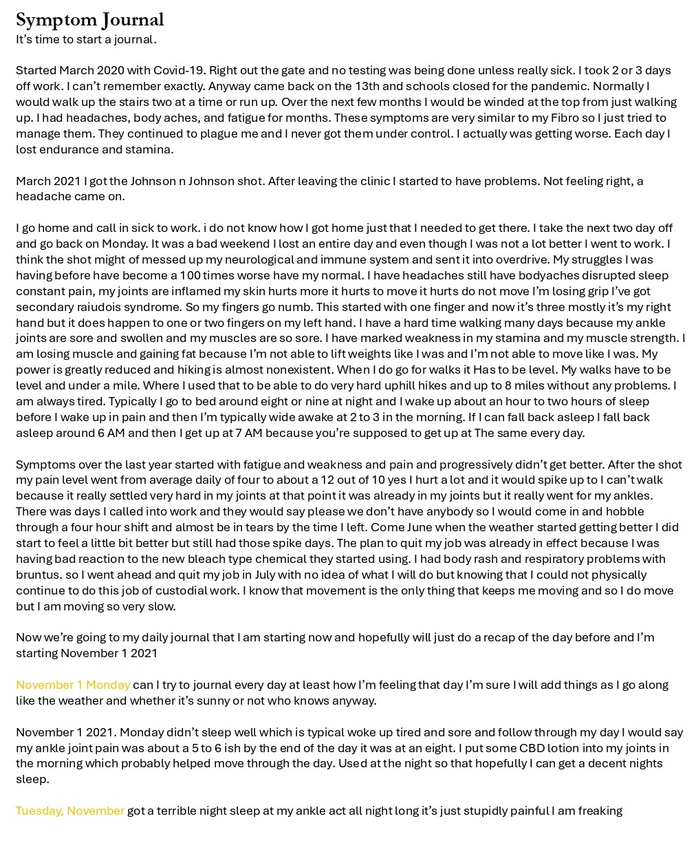
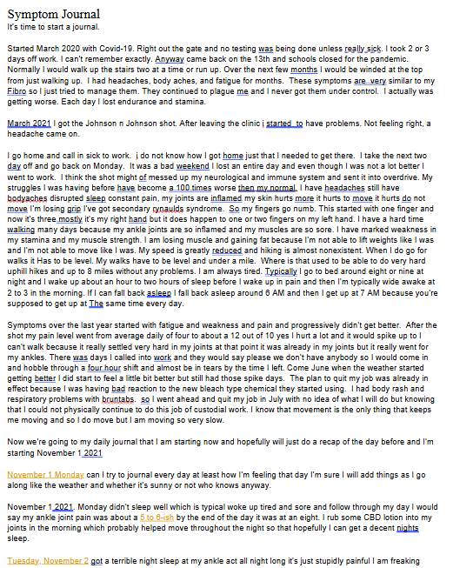
Example:
Symptom
Journal

Slide 28
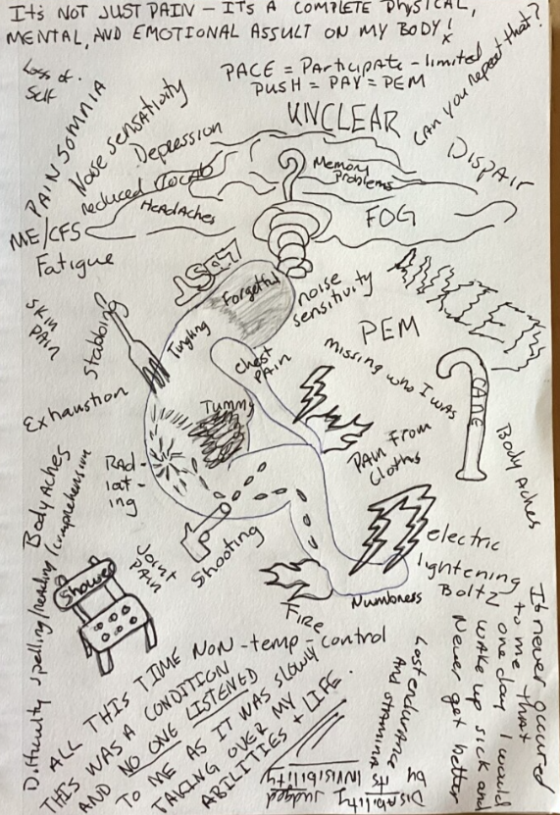
Example:
Symptom
Drawing

Slide 29
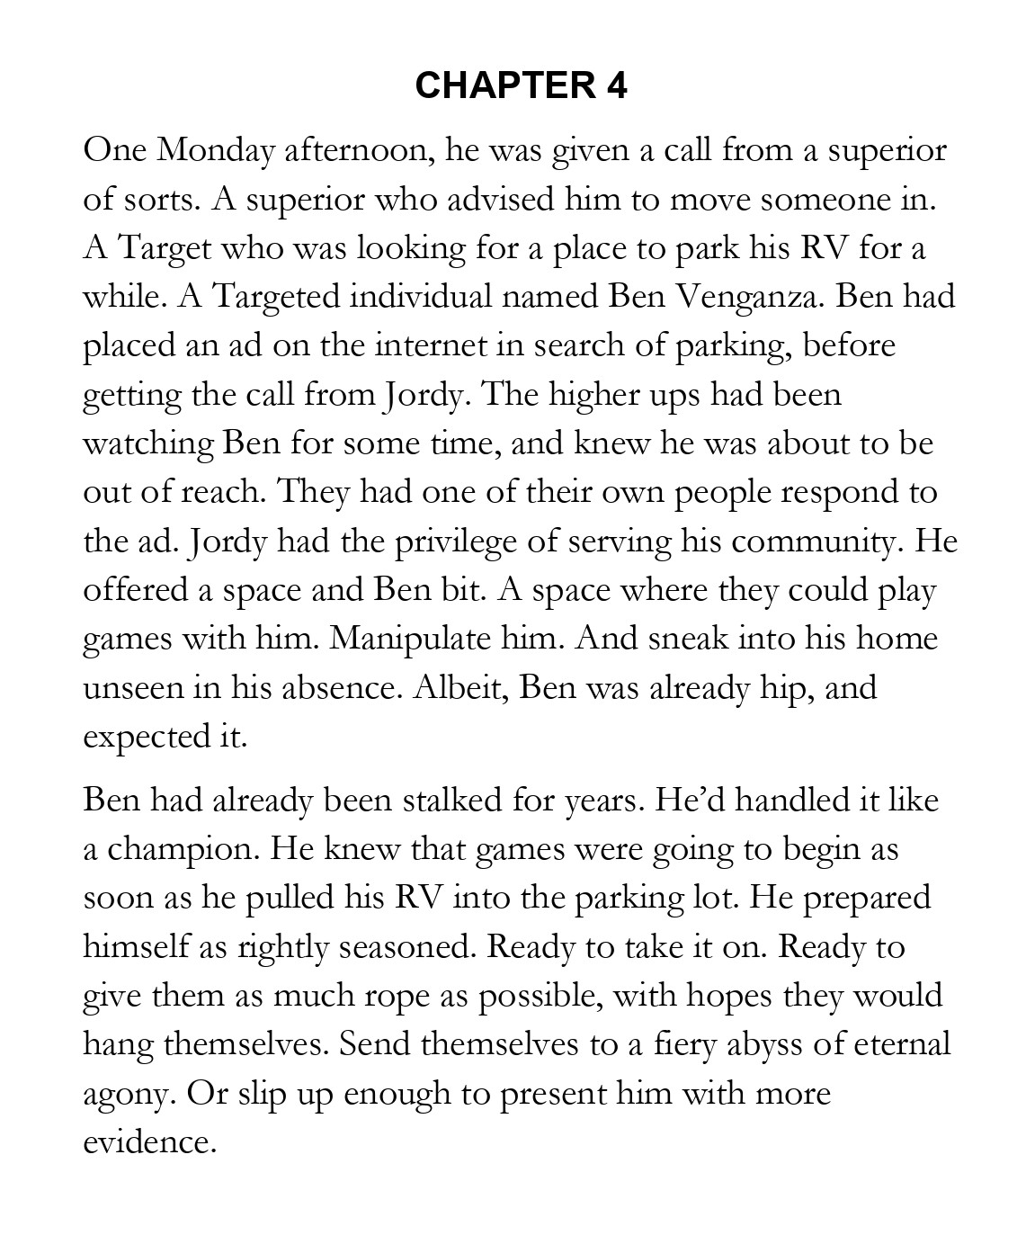
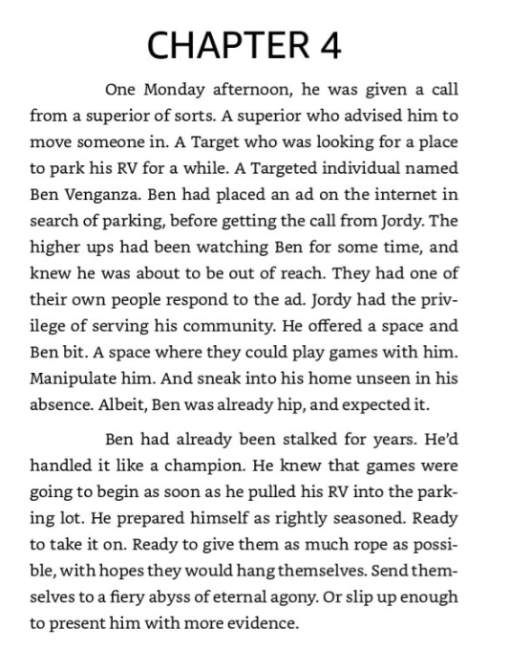
Example:
Excerpt from
Client Mémoire

Slide 30
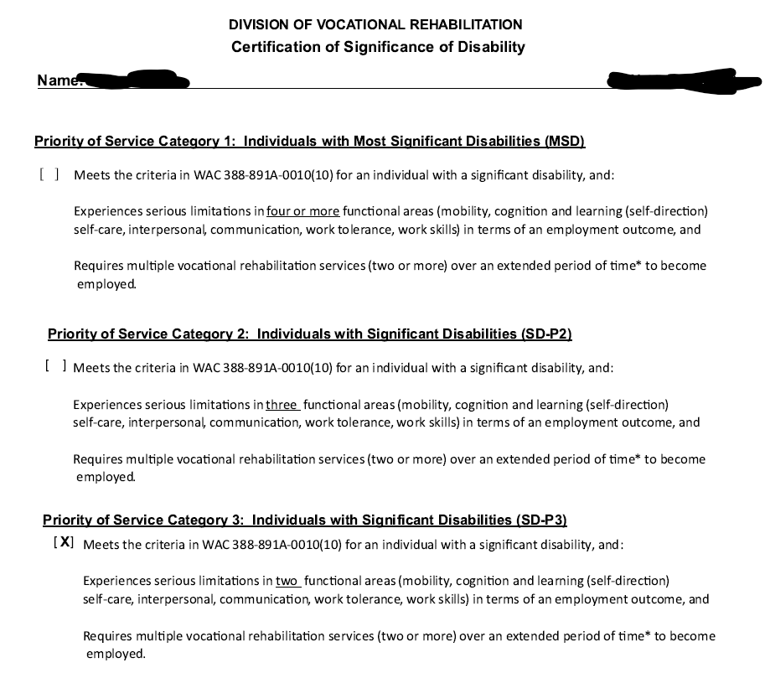
Example: Voc Rehab Criteria for Services

Slide 31
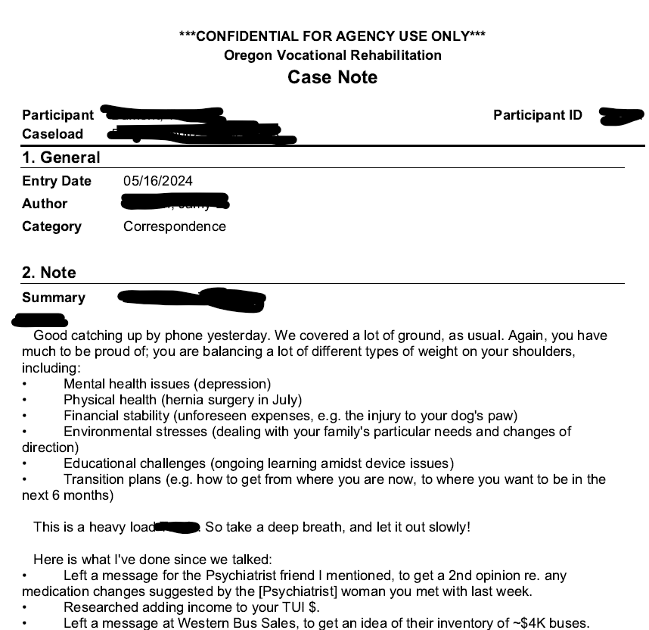
Example: Documenting Assistance Needed w/ School & Job Placement, other barriers to Work

Slide 32
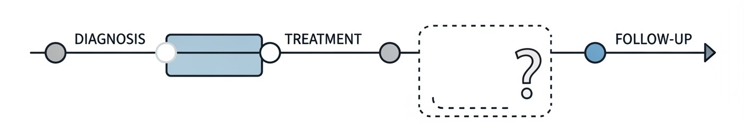
“No Evidence” Can Be Evidence — in Context
Missing evidence as circumstantial Evidence
  Under the FRE, Rule 401 (Relevance) and Rule 403 (Exclusion for Prejudice), even the lack of something can be relevant if it tends to make a fact more or less probable than it would be without that absence.
In practice: Lack of Medical Treatment
  History of psych impatient stays noting “fear” of medical providers for lack of treatment… and lack of treatment in the F section.

Slide 33
Other Evidence: Limitations at School

Slide 34
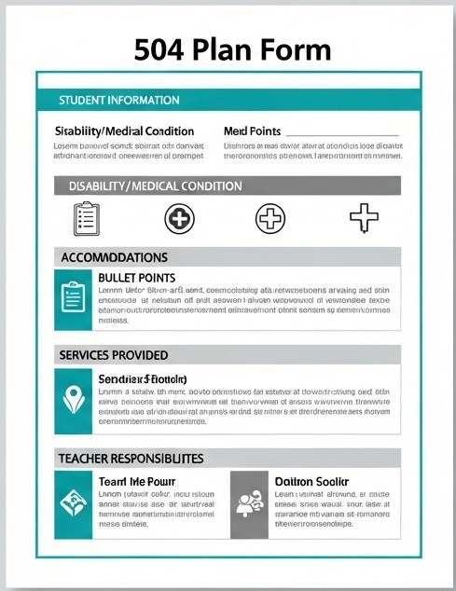
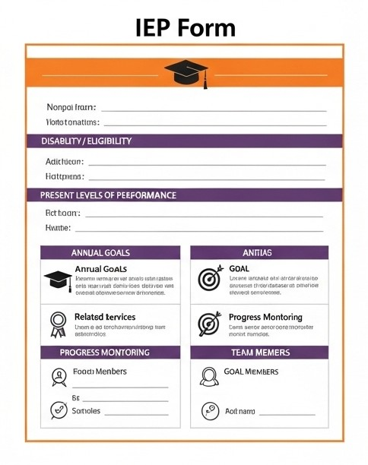
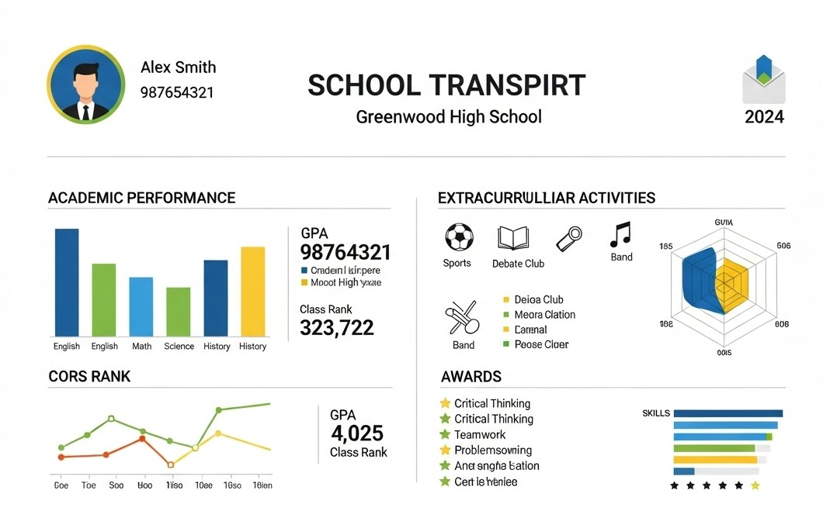
Examples of Other Evidence Documenting Limitations at school
  504 Plans & IEPs
  Accommodations through a college’s Office of Disability Services
  Opinions from Teachers or day care provers re: Functioning in Childhood Domains or special accommodations given in the classroom
  School Transcripts
  Attendance Records
  Disciplinary Records

Slide 35
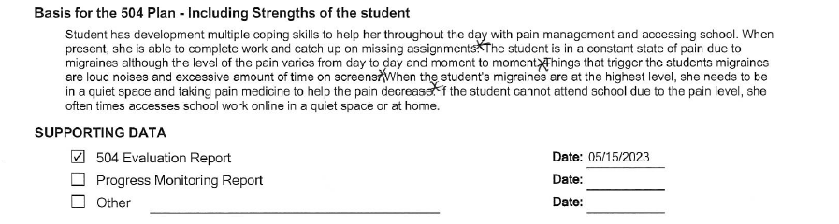
Ex. School Accommodations for Child w/ Migraines

Slide 36
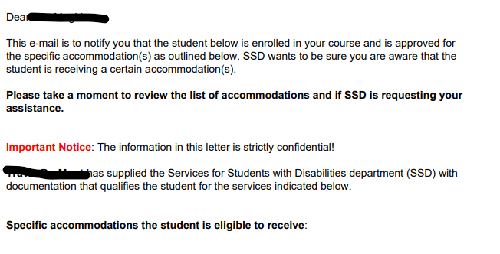
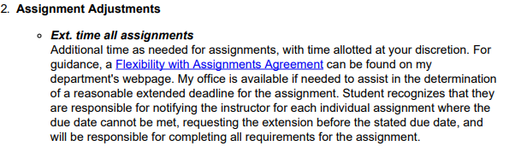


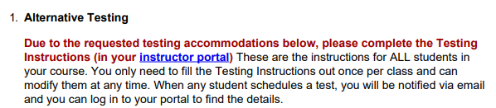
Ex. Specific Accommodations for College Classes

Slide 37
Other Evidence: Limitations at Work

Slide 38
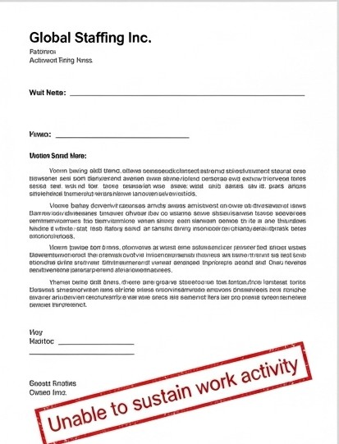
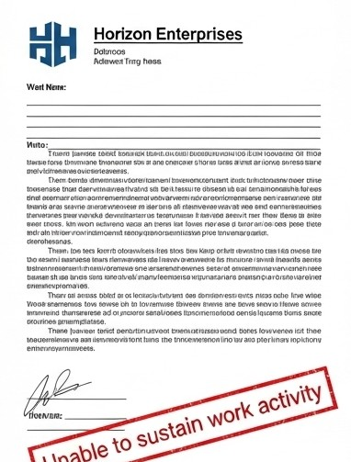
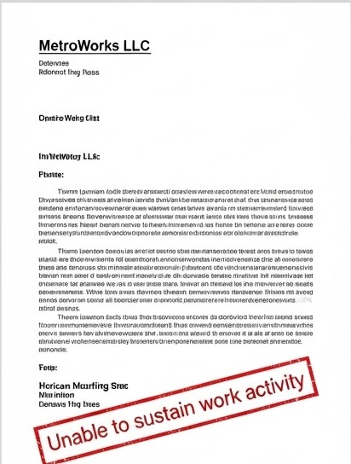
Unsuccessful Work Attempts (UWAs)
Strings of UWAs will be apparent in the earnings queries
It can be helpful to get evidence that supports why the client keeps failing a work
  Example: Employer Statements about Why Jobs Ended, Employment Files documenting disciplinary issues
Earnings records documenting how long jobs lasted (must be less than 6 months for a UWA) and how much was made on a monthly basis, can be VERY important

Slide 39
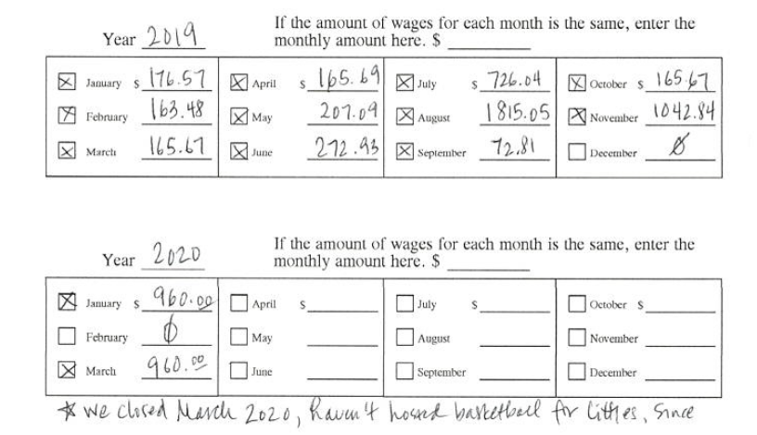
Example – Employer Verification of Monthly Wages, SSA Form L725-F3

Slide 40
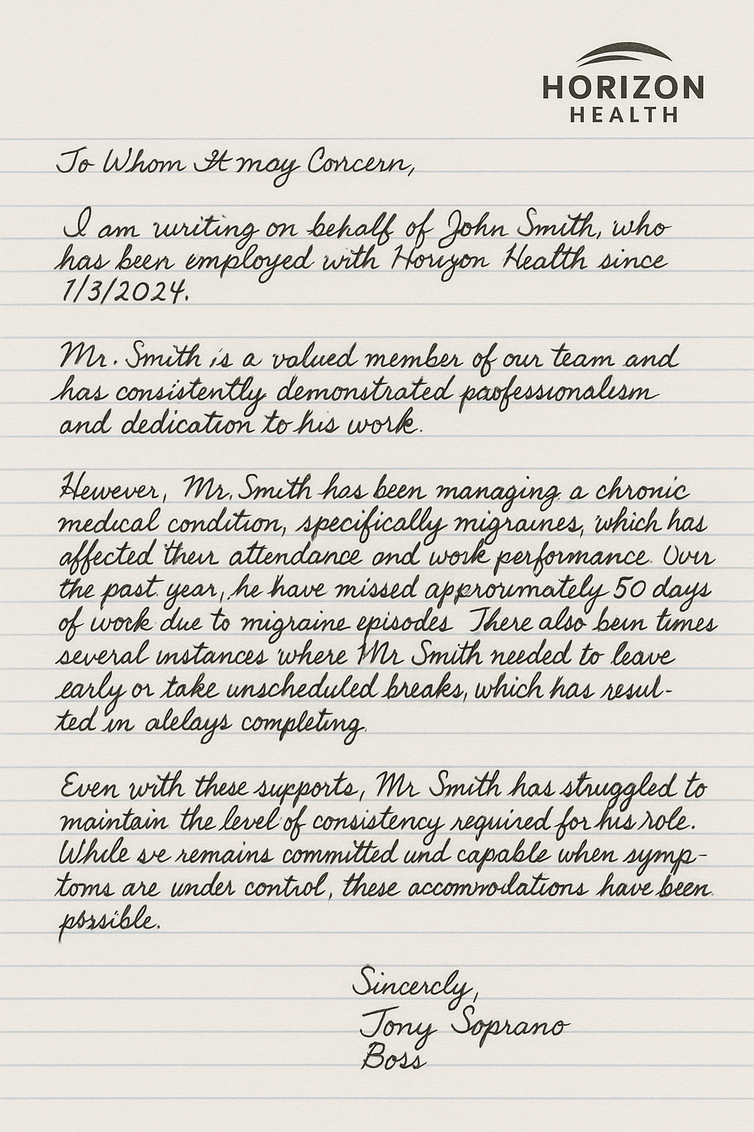
Examples of Other Evidence Documenting Problems at Work
  Work Activity Questionnaire (SSA Form 3033) – Recently updated!
  Statements from employers
  Disciplinary Actions
  Attendance & Requests for Medical/Sick Leave
  Orders Denying Unemployment

Slide 41
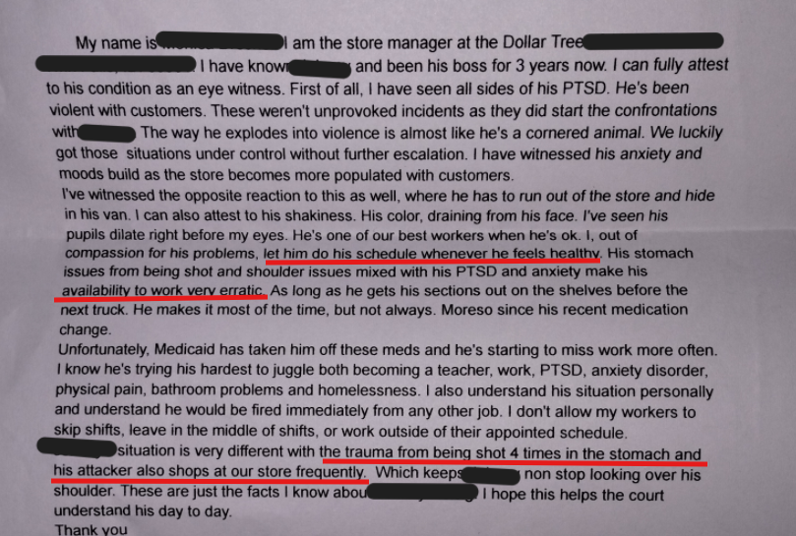
Ex. Employer Statement re: Worker’s Inability to Sustain Competitive Employment Full Time

Slide 42
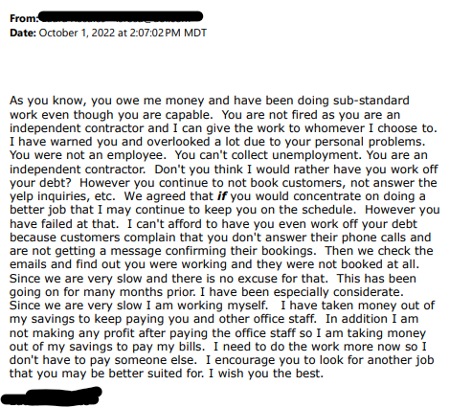
Ex. Employer Email re: Angry at Employee for Doing a Crappy Job/Establishing Productivity Issues

Slide 43
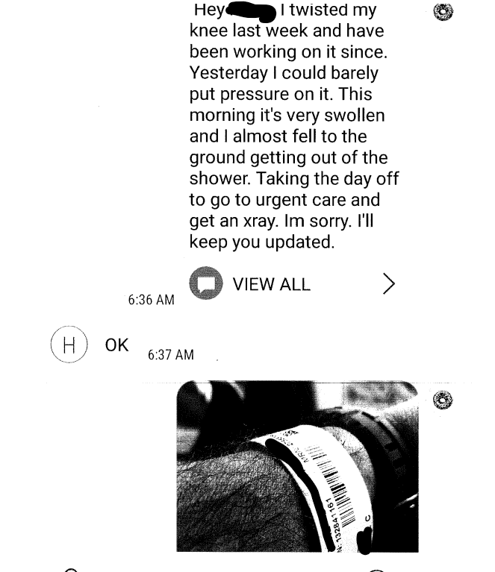
Ex. Documenting Work Ended Due to Medical
Conditions

Slide 44
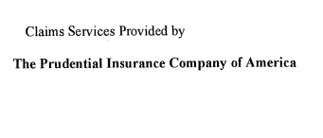
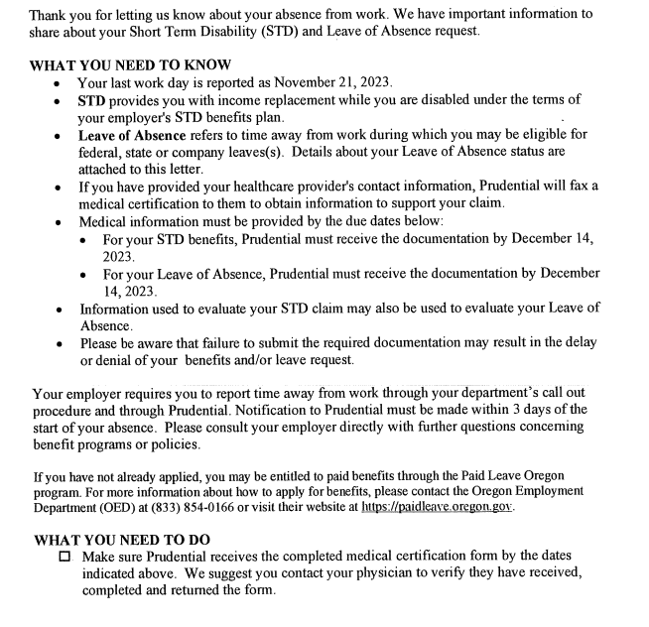
Ex. Documenting Leaves of Absence

Slide 45

Subsidized Work
SGA for 2025 is $1,620/month for non-blind individuals (subject to annual adjustments).
Subsidized work is when the true value of an impaired employee’s work (when compared to the same work completed by an unimpaired employee) is considered to be less than the impaired employee’s earnings.
For example: an employee with a serious impairment may complete fewer tasks or simpler work than their peers.
SSA calculates the subsidy (the disparity of work value vs. earnings) and subtracts that amount from a claimant’s gross earnings to determine the claimant’s countable earnings that reflect the value of their work.

Slide 46
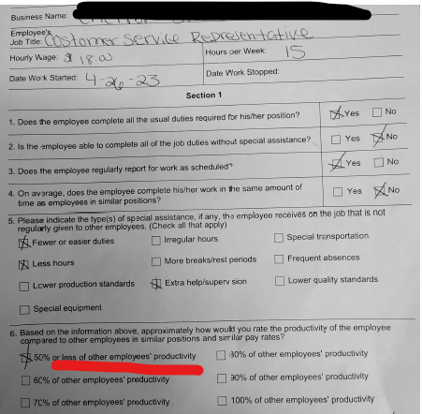
Ex. Completed SSA 3033 – Old Version

Slide 47
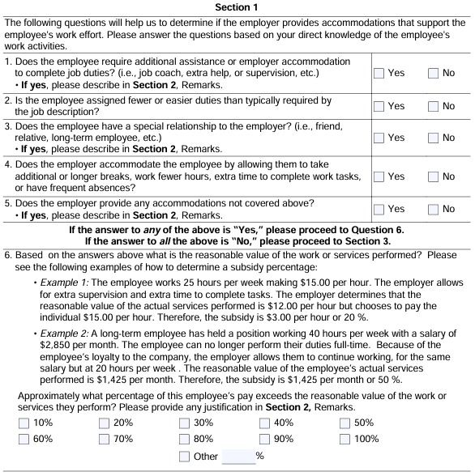
The New SSA-3033 – Pay Attention to the Examples!

Slide 48

Sheltered or Special Work Environments
Sheltered work is work activity completed in a therapeutic setting or while on limited duty.
  Submit Documentation of Program Eligibility that shows:
    Work is not competitive
    Productivity is not expected to be same as that of workers w/out disabilities.

Slide 49
Other Evidence: Vocational Rebuttal Evidence

Slide 50
Check Out Our Resources/NOSSCR tab on getssd.com for many examples of VE Rebuttal
Specifically, materials from these past presentations:
  There Are No Sedentary Unskilled Jobs Anymore: What to Do if a VE Says There Are (2024)
  Be Practical: Dealing with Step 4 in Real Life (2020)
  “Gotcha’: Building your case for appeal based on Vocational Issues (2019)
Common Types of Vocational Rebuttal Evidence We Submit
  Print-offs from Job Browser Pro
  Print-offs from the ORS
  Memorandum About the Inadequacies of the ORS, courtesy of JBP

Slide 51



Contact Info
getssd.com
kevin.kerr@getssd.com
sara.carroll@getssd.com
elmira.s@getssd.com

